Slide 1
Module 5.6.1: Files

Slide 2
What are Files?
Files are a long sequence of bytes, saved on the hard disk.
Sometimes we will want to read them, and sometimes to write them.
Thankfully, this is very easy to do in Python!

Slide 3
So what are files?
Files are a long sequence of bytes.
Not characters.
Not letters.
Bytes!
So what do we read from files?
Bytes.
What do we write to files?
Bytes!

Slide 4
How do we create bytes?
In order to create bytes, we need to encode strings.
What is an encoding?
Let’s remind ourselves what ASCII is.

Slide 5
Character Set
A character set is a group of all possible characters in a certain encoding.
An encoding is a way to turn a string into a series of bits (but more on that in a future lesson).
The most common character set is ASCII – in which all characters are encoded into 1 byte (8 bits).

Slide 6
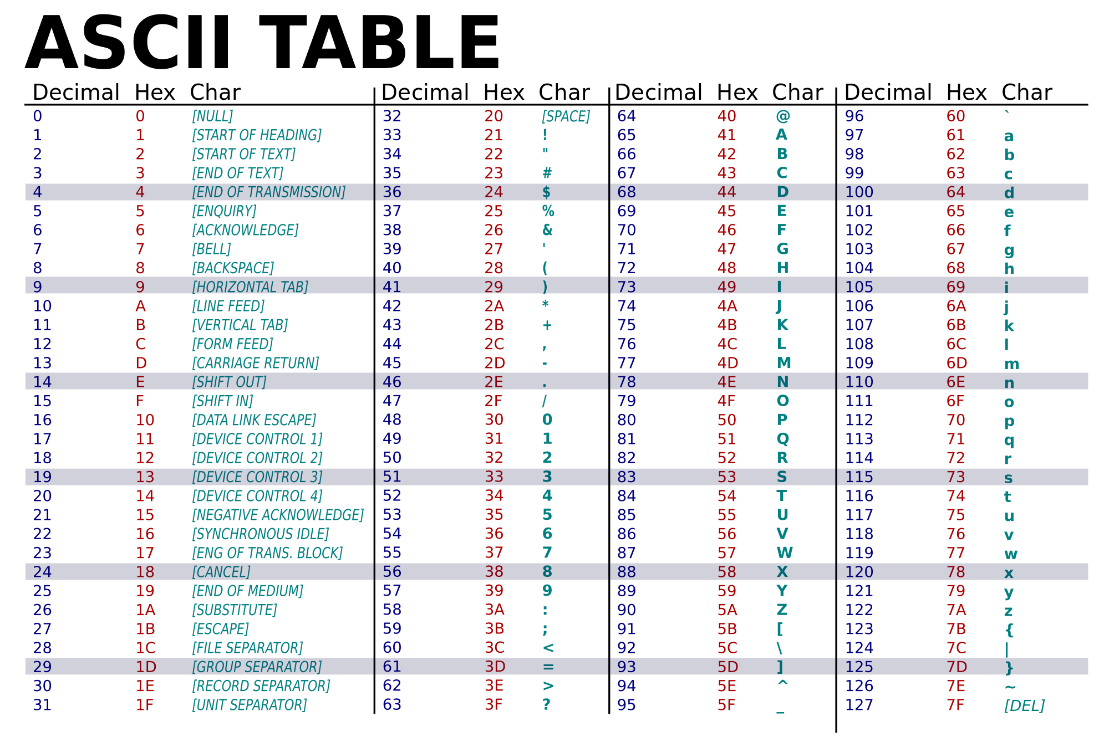
Notes:
https://medium.com/interview-buddy/handling-ascii-character-in-python-58993859c38e

Slide 7
So to Encode is to What?
To encode is to translate a string into the bytes that represent each letter.
ASCII is the easiest encoding, useful only with English. We will learn other encodings in the future.
For example, encoding ‘A’ using ASCII is to translate ‘A’ into the hexadecimal byte 41, written in Python as ‘\x41’.
This turns a string object into a bytes object.

Slide 8
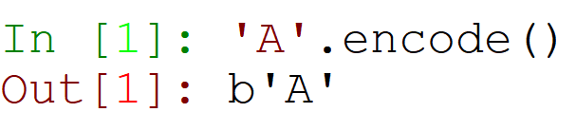
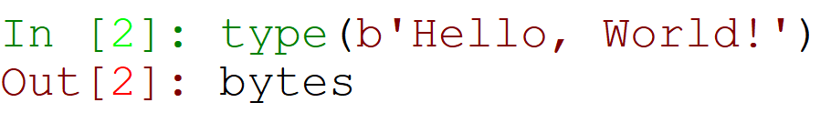
Creating Bytes in Python
It’s as easy as that.
The b before the quotes shows that these are bytes, not a string.
This is what we can use in order to write strings to files!
We can also create bytes by ourselves, by writing b before the string definition:

Slide 9
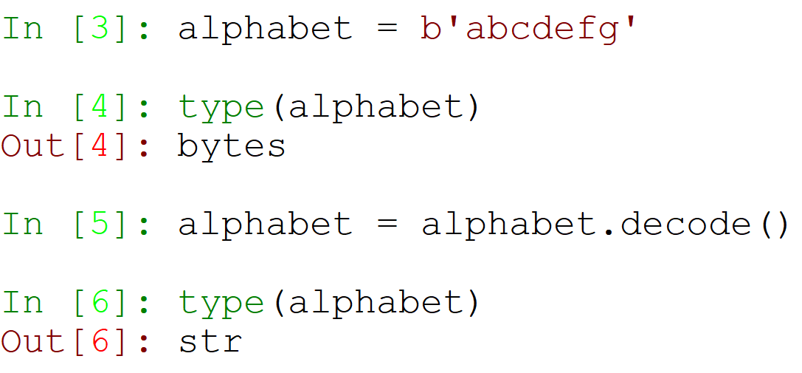
Converting Bytes into Strings
The same can be done the other way around.
Bytes can be converted into the strings that they represent by using the .decode() string method:

Slide 10
Your Handy Guide
encode
‘string’
b’bytes’
decode

Slide 11
Saving Paths
Let’s remember what we learned in our “strings” lesson…

Slide 12
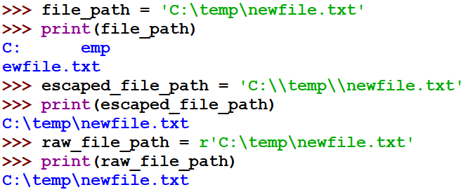
Raw Strings - No Escapes Allowed
Using raw strings, Python ignores all backslashes, not treating them as escape characters anymore.
To define a raw string, add ‘r’ before defining your string.
Notes:
In our regular definition, our path get warped because of an assumed tab and newline.
In order to get a correct path, we can use double backslashes (as an escaping for backslashes).
This can get annoying to edit and write, so we can create a raw string by only adding an ‘r’ before the string definition. Thus, no backslash is treated as an escape, and our path stays unedited.

Slide 13
Accessing a File
To access a file, we will use the open function.
Open receives two inputs: the file path, and the mode.
We will use one of two modes:
“rb” – used for reading files
“wb” – used for writing files

Slide 14
Closing the File
When we access a file and open it, our Operating System locks it only for us. This means no one else can access it while the file is open.
This means that once we are done using the file (reading/writing), we will always want to close it. If we don’t others will not be able to access it.
We close the file using the .close() method.

Slide 15
Reading a File
Step 1 – Opening the file – using the open() function, and giving the path, and the mode ‘rb’
Step 2 – Reading the data – using the method .read()
Step 3 – Closing the file – using the method .close()

Slide 16
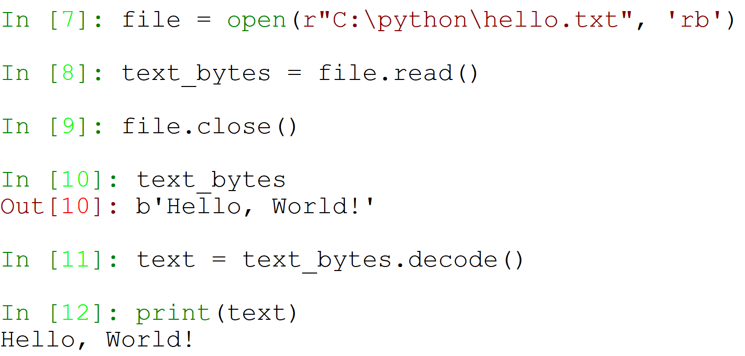
Reading a File (cont.)

Slide 17
Writing a File
Step 1 – Opening the file – using the open() function, and giving the path, and the mode ‘wb’
Step 2 – Writing the data – using the method .write(), and giving the bytes we want to write.
Step 3 – Closing the file – using the method .close()

Slide 18
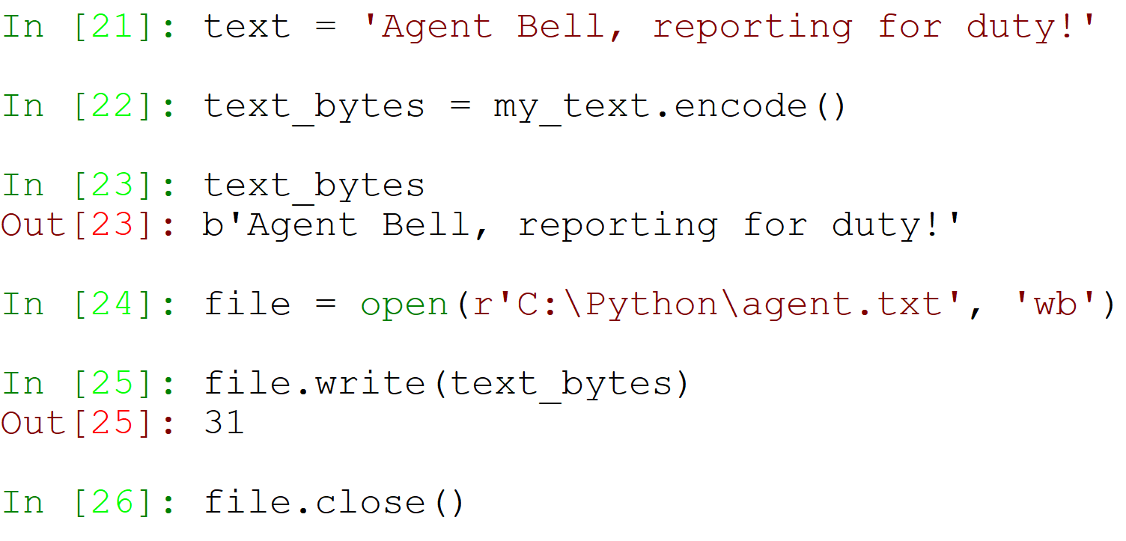
Writing a File (cont.)

Slide 19
The Path of the File to Write
The path you give the open() function when writing can be an existent file, or an inexistent file.
If the file doesn’t exist – a new file will be created.
If the file exists – the existing file will be erased and replaced.
But, if the directory the file is located in doesn’t exist – an error will be raised.

Slide 20
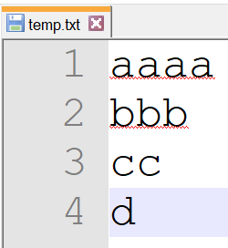
Reading
Let’s go back to reading a file. We’ll use this file, named temp.txt:

Slide 21
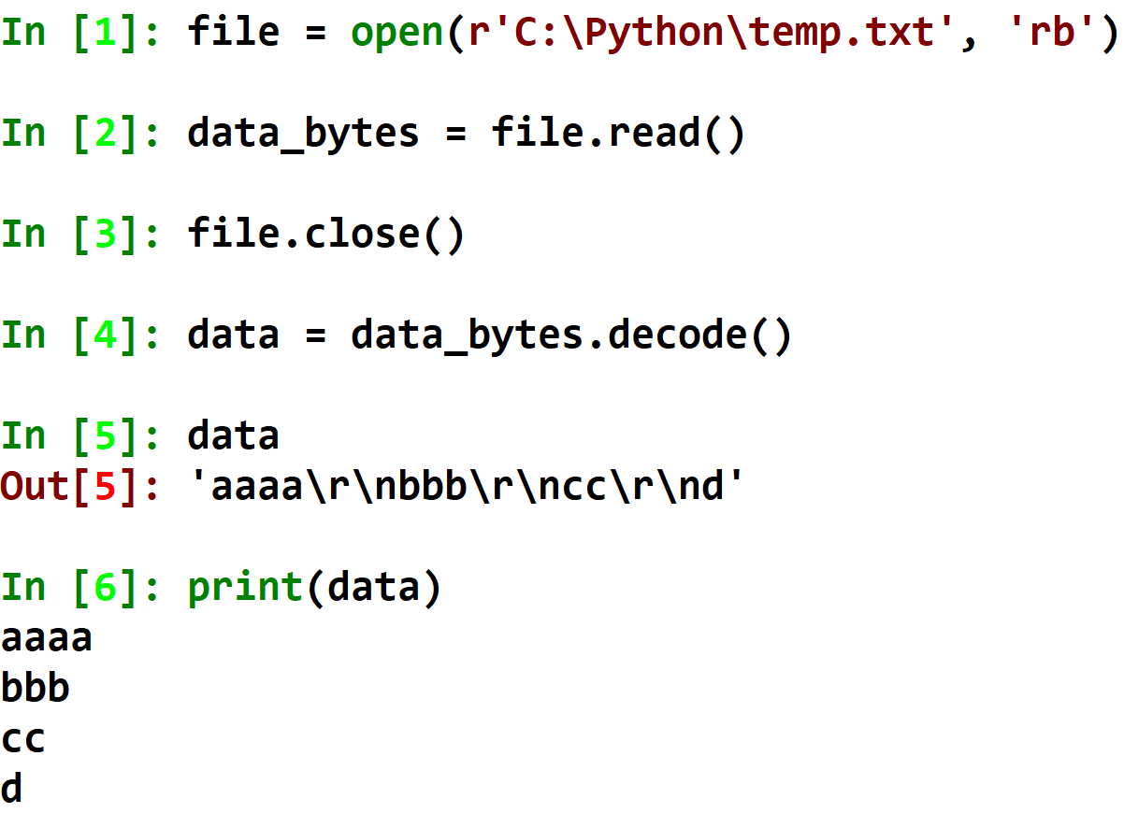
Reading
Notes:
Just like earlier, we use the mode “rb”, read our bytes from the file, and close the file.
Then, we can get our string by using the decode() method.
This gives us data with newlines – the Windows newline is \r\n.
We can print out our string to show these newlines in action!

Slide 22
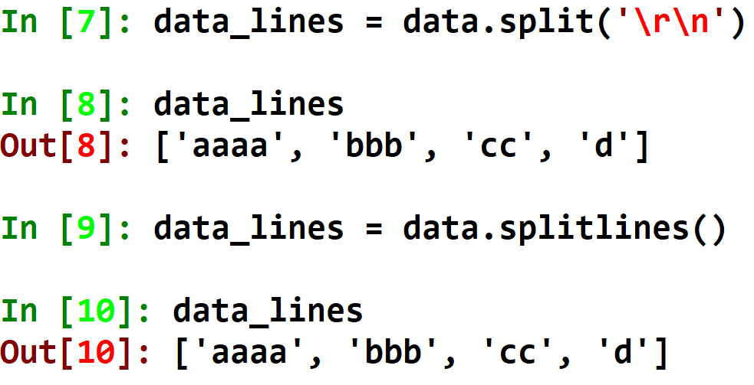
Splitting Text into Lines
We can use the .split() method, with the newline character as the delimiter.
We can also use the .splitlines() method, which is much easier!

Slide 23
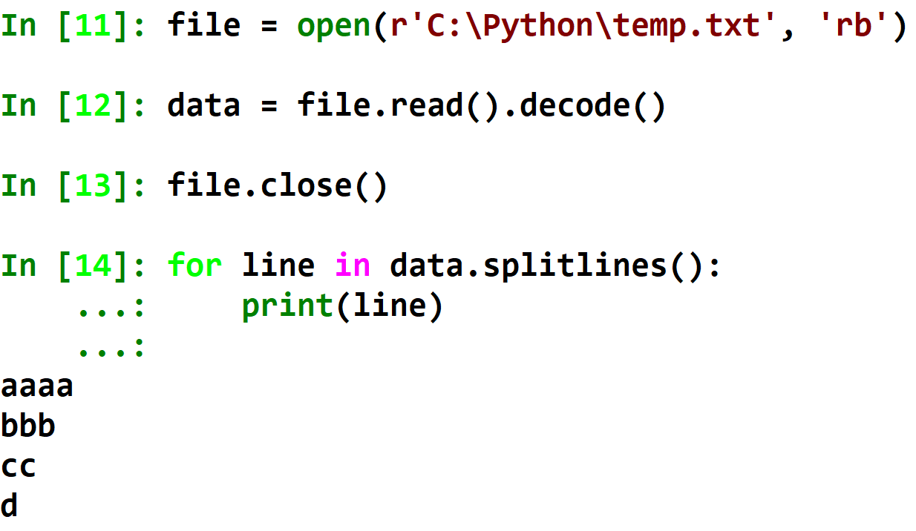
Reading Lines from a File
Notes:
We can chain together methods in order for our code to be shorter and more beautiful!

Slide 24
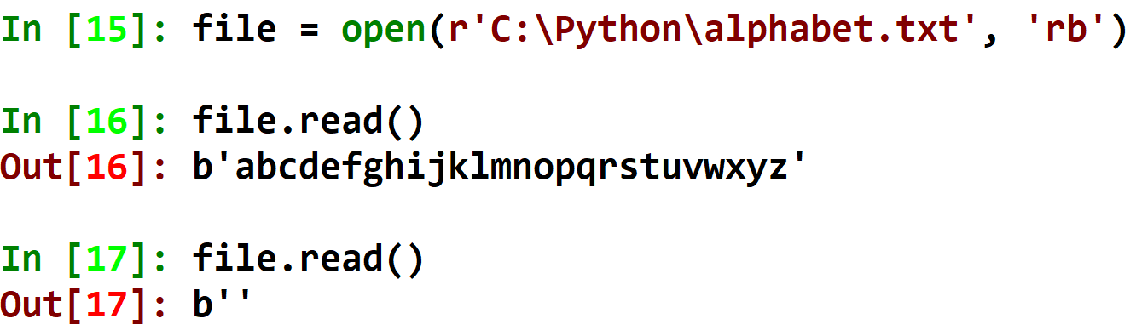
The .read() Method
Read, when executed without an input, reads all of the bytes of the file. What happens if we use it twice?

Slide 25
File Pointer
Just like in variables, our pointer shows us where in the file we read from.
When the file has just been opened, the file pointer points to the beginning of the file. As the file is being read, the pointer advances over the bytes of the file.
When all bytes have been read, the pointer is already at the end of the file, so executing the .read() method again will read 0 more bytes.

Slide 26
File Pointer in Action
abcdefghijklmnopqrstuvwxyz

Slide 27
.read(num_of_bytes)
Instead of using .read() to read the whole file, we can give it the number of bytes to read.
The pointer will walk along with it!

Slide 28
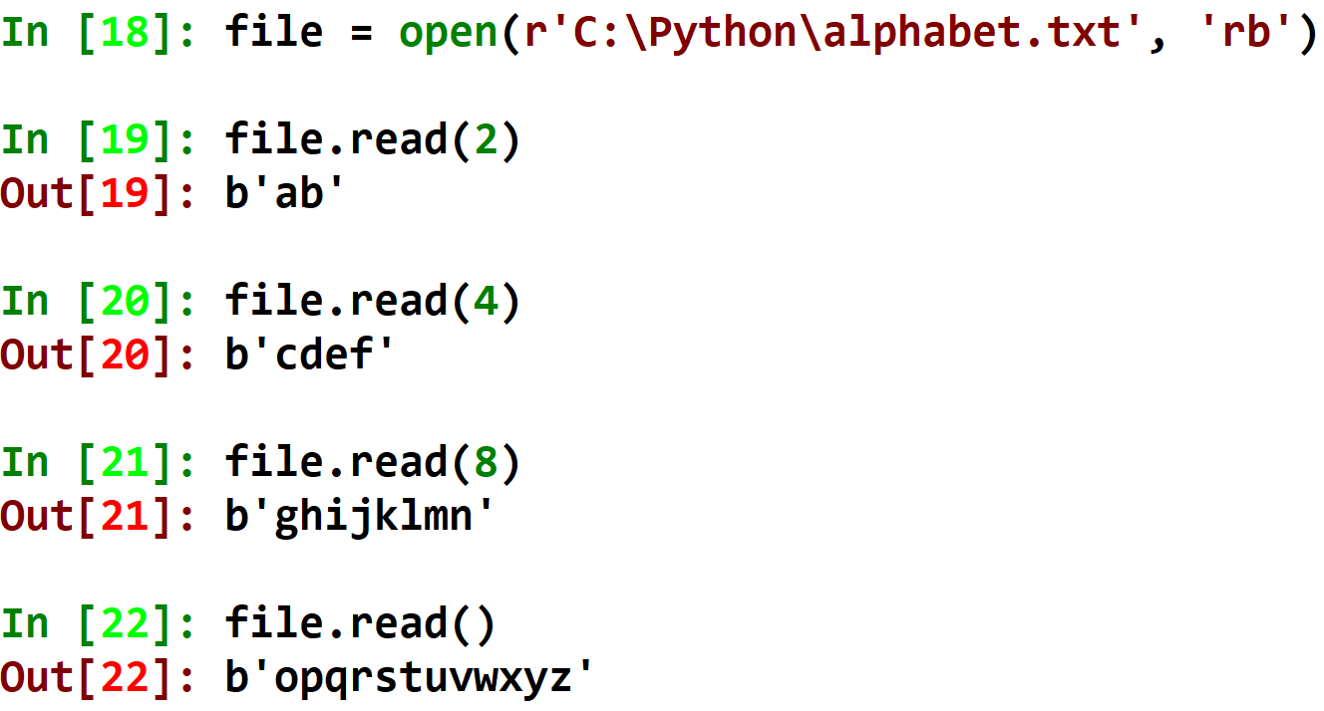
abcdefghijklmnopqrstuvwxyz

Slide 29
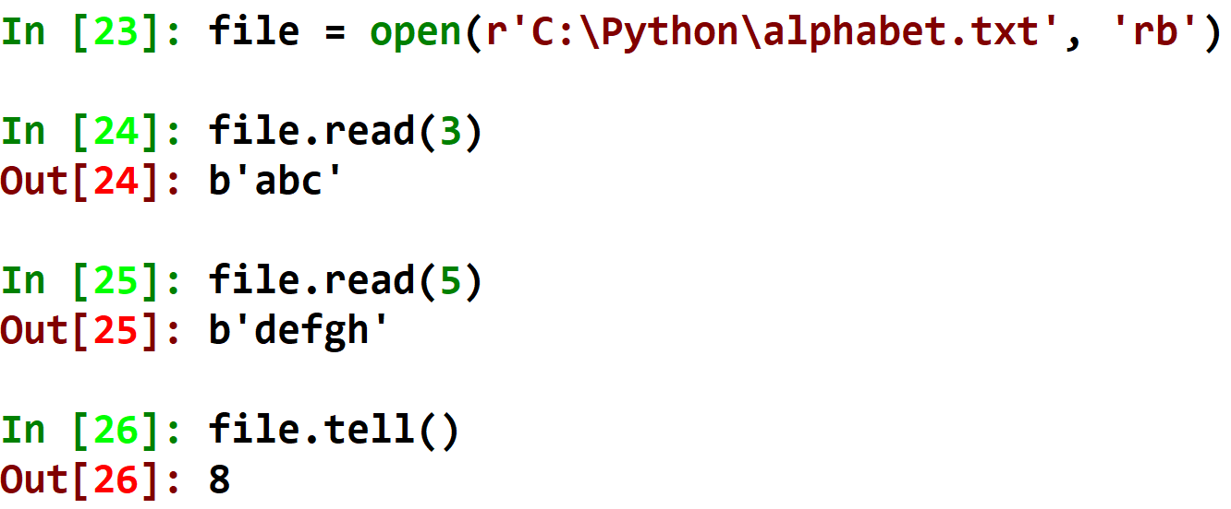
Where is My Pointer Now? - .tell()
We can use the .tell() method to ask where the pointer is currently placed:
Where is the pointer now?
8 bytes in!

Slide 30
Changing the Pointer Position
I can change the pointer’s position by using the method .seek(), and giving the position to change to.

Slide 31
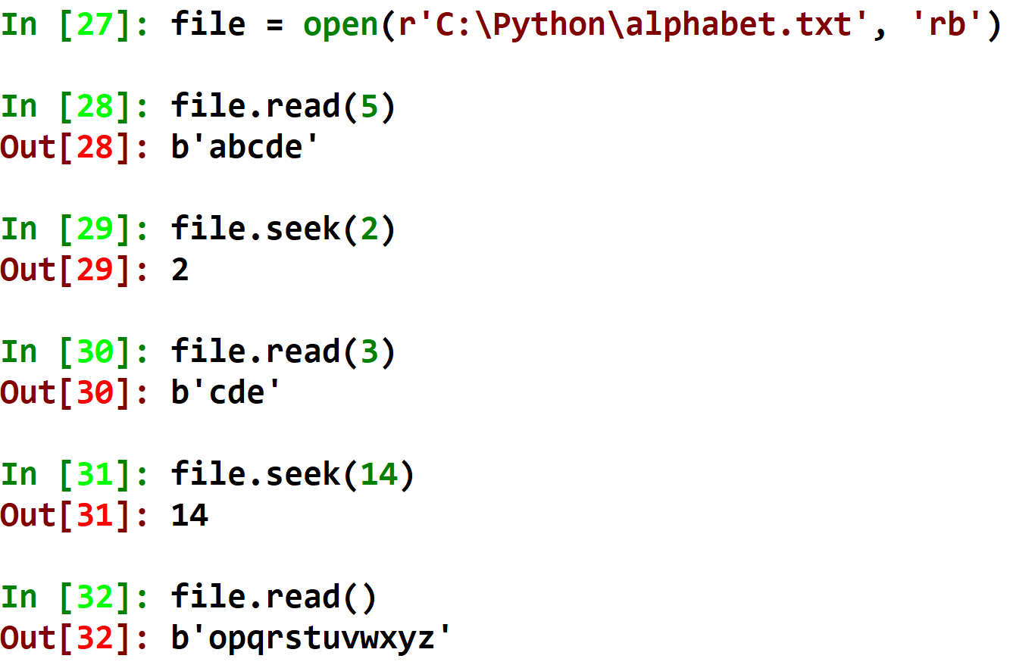
abcdefghijklmnopqrstuvwxyz

Slide 32
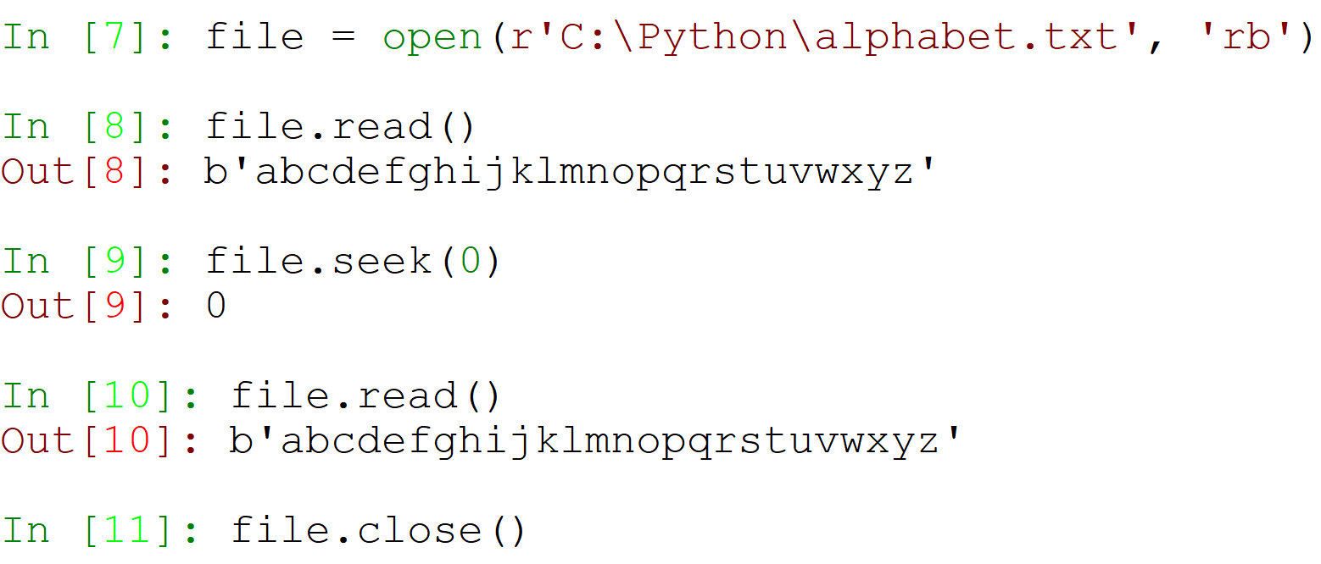
Reading the File Twice
So, in order for us to reread the file (use the .read() method twice), all we need to do is to reset the pointer to the beginning of the file!

Slide 33
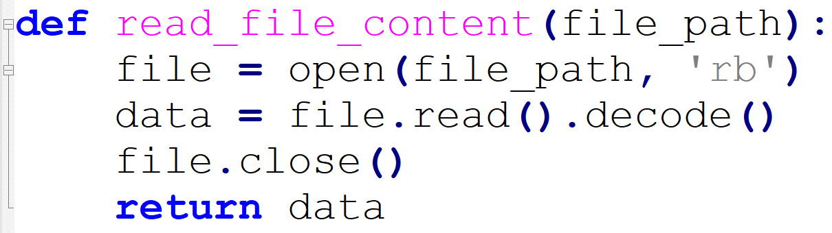
The with Keyword
Up until now, opening a file took a few lines, and you had to make sure you remember to close the file.

Slide 34
The with Keyword (cont.)
But what if you forget to close the file?
Or what if an error gets raised, before the .close() method was executed?

Slide 35
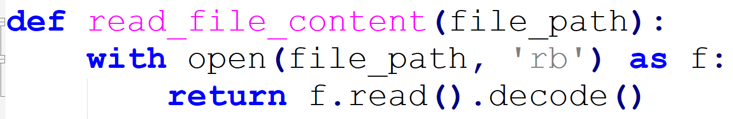
The with Keyword - Reading
Using with, we can handle files easier!
The with creates the open() object and saves it in the variable f.
It also makes sure to execute .close() for you, even if an error happens!

Slide 36
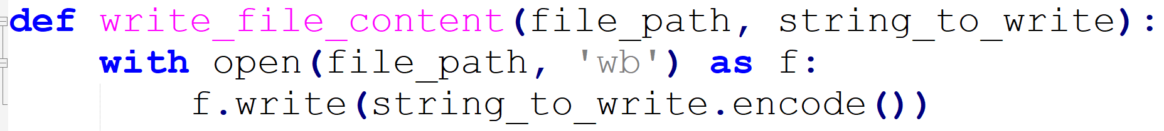
The with Keyword - Writing

Slide 37
Modes Without ‘b’
Apart from modes ‘rb’ and ‘wb’, there are the modes ‘r’ and ‘w’.
Repeat after me: We will never use modes ‘r’ and ‘w’!
Explanation:
Whenever we read or write English text files, there are certain bytes that make the writing/reading stop when the pointer reaches them.
We will usually write and read files that are not English text, which means that these bytes should be ignored.
The ‘b’ in the mode stands for binary. This means that we should write and read our files, while ignoring the stopping bytes.
This is why we will always use the binary modes!

Slide 38
Summary
Files are a sequence of bytes
The byte type
Encoding and Decoding
Reading Files (mode ‘rb’)
Writing Files (mode ‘wb’)
Reading Multi-line Text
File Pointers – the read, tell and seek Methods
The with Keyword

